Slide 1
Equity and Travel Demand Models: Translating philosophies of justice into actionable model outputs
Dr. Matthew Palm
November 13, 2024

Slide 2
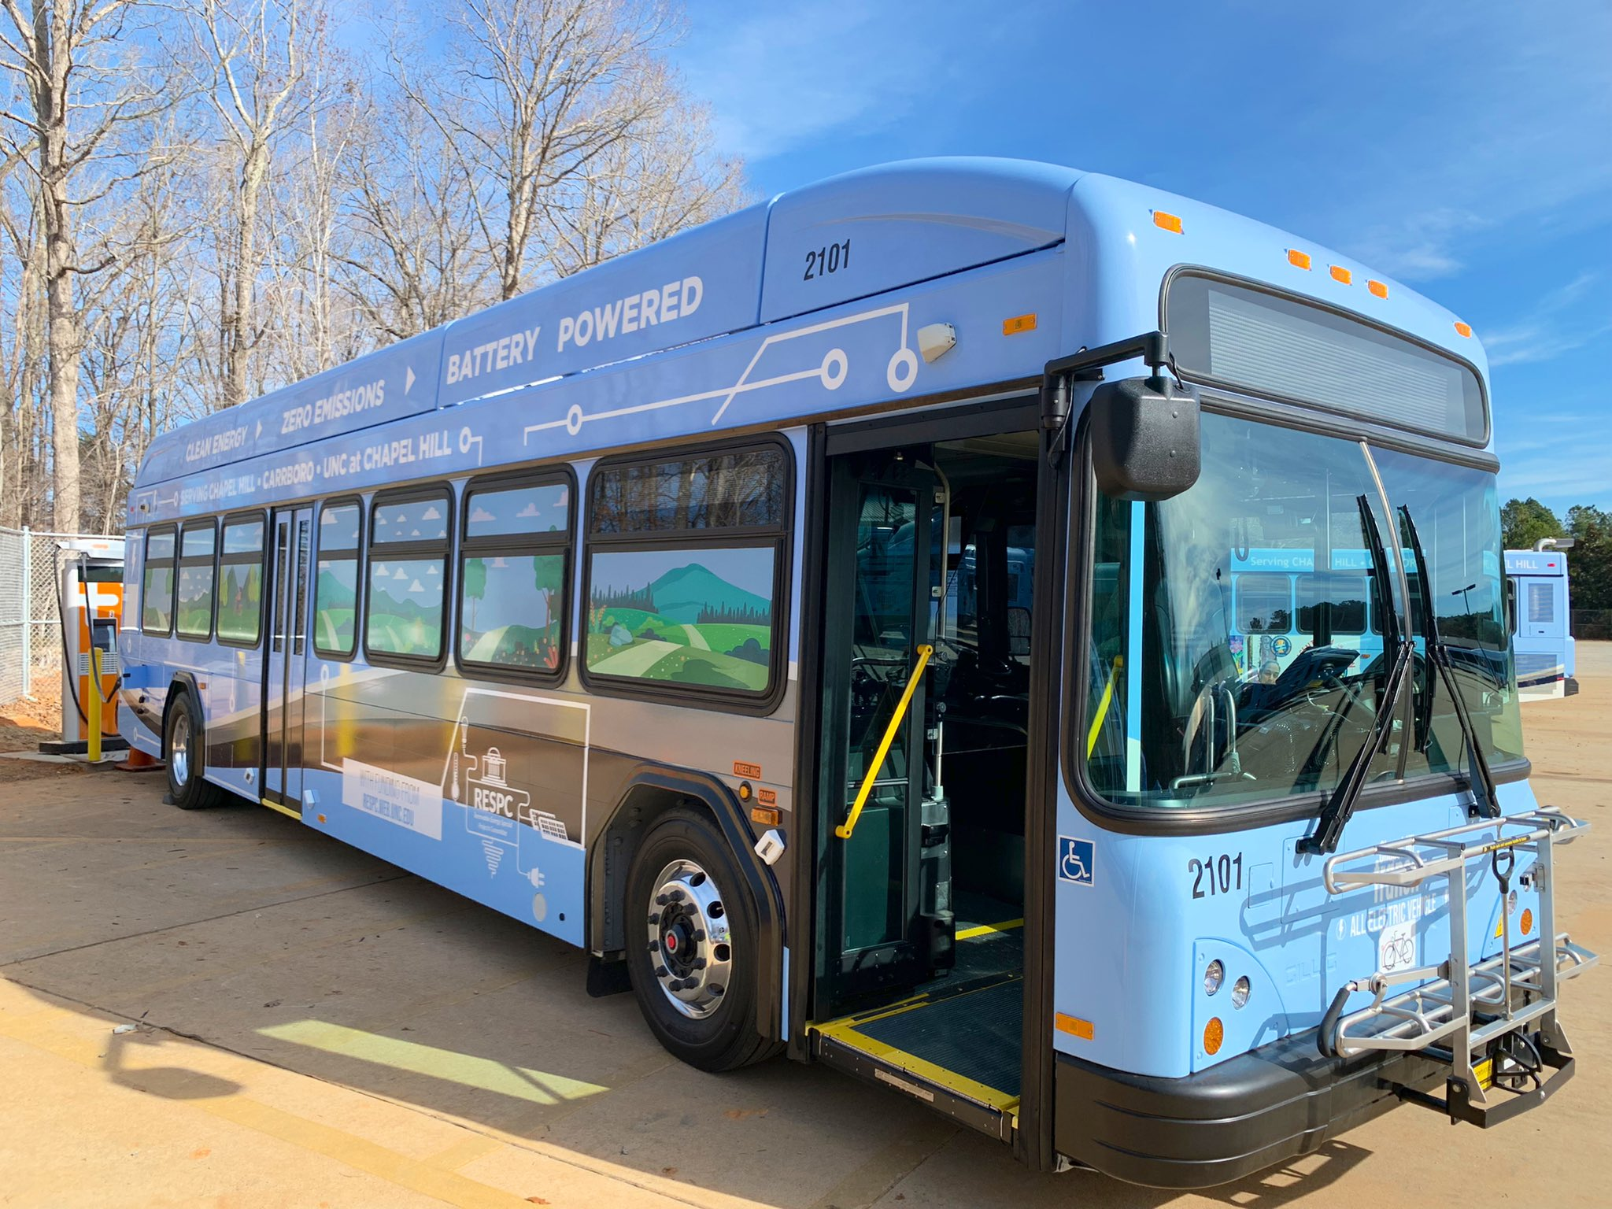
Agenda
Agenda
Justice and equity
Why care
Distributions of what
Philosophies of justice
State of the art
Conclusions

Slide 3
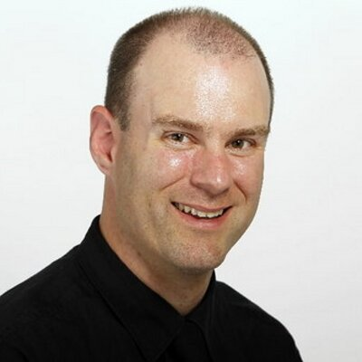
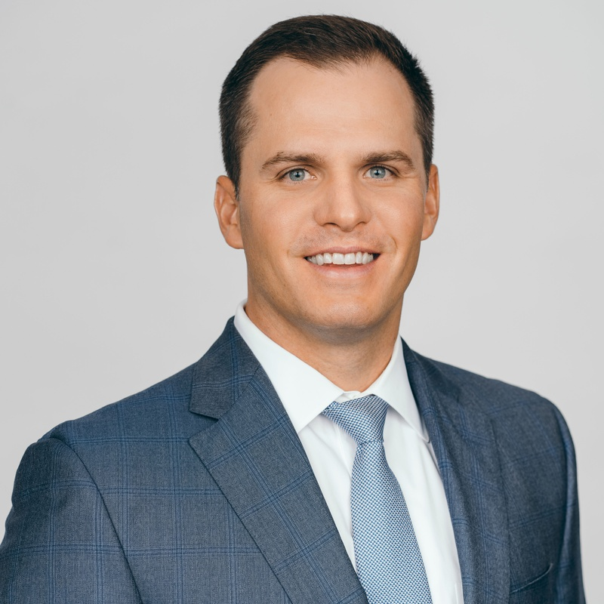
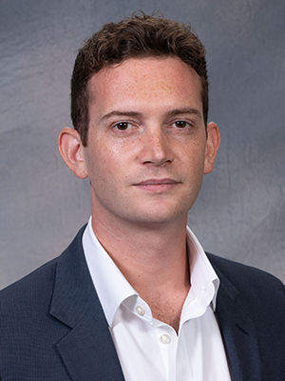
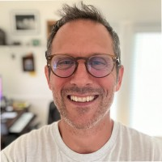
About me
Agenda
Prior employers: U. Toronto, U. Melbourne.
Transportation research:
Social and community impacts (‘public value’)
Equity and justice issues
Nighttime travel behavior and planning.
palmmatt@unc.edu
Other “Matthew Palm”s?

Slide 4
What is justice in transportation?
overview
“Transport justice encompasses moral and political concerns related to equity, democracy, and diversity in the pursuit of more just cities and mobility systems.”
-Karner & Pereira, 2021

Slide 5
Equity—where travel demand models help
Overview
The fairness/justness of the distribution of transportation system benefits and burdens.
Sometimes referred to as distributive justice.

Slide 6
Why care?

Slide 7
Why care about this?
Why care
Transportation-related social exclusion (TRSE): when a lack of transportation reduces an individuals’ ability to participate fully in the economy and society.
Inequitable or unjust distributions of transportation resources can make it difficult for some populations to participate fully in society.

Slide 8
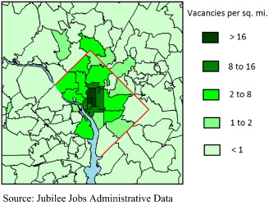
Experimental Evidence: Jubilee Jobs
Why care
Washington D.C. Employment agency interested in impact of transit fare discounts on client job search outcomes and get a federal grant to test the idea.
They partner with economist David Phillips.
Phillips randomly offers their clients a DC transit fare card with $50 loaded.
People who got the fare card were 9% more likely to get a job within the first 40 days of their job search.
Phillips (2014)

Slide 9
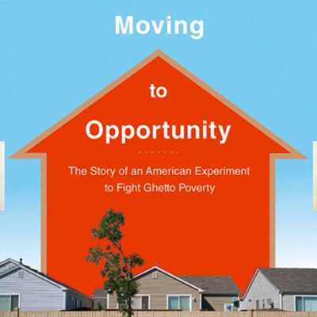
Experimental Evidence: MTO
Why care
For people given housing vouchers in the USA, “We find that keeping or gaining access to an automobile is positively related to the likelihood of employment”
but “Improved access to public transit is positively associated with maintaining employment, but not with job gains. ”
Blumenberg & Pierce (2014)

Slide 10
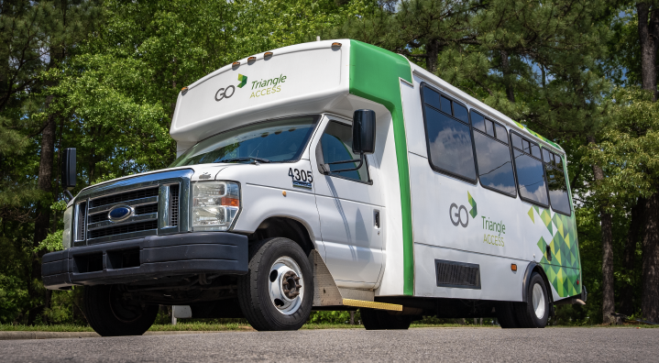
Transportation access impacts many outcomes…
Why care
Voting (Garnett & Grogan, 2021)
Food (Liu et al., 2020; Christian, 2010).
After school activity participation, school choice, higher ed activity participation (Allen & Farber 2018; Palm & Farber, 2020)
Healthcare (Syed et al., 2013; Tierney et al., 2000; Smith et al.; 2022).
Social capital (Castel & Farber, 2017).
Mental health and well-being

Slide 11
Distributions of what??

Slide 12
Distributive justice—who wins, who loses?
Distributions of what
Clean Air Act
Clean Water Act
NEPA
Section 4F
EO 12898 (EJ)
Relocation Assistance (49 CFR Part 24)
Title VI
Title VI… kind of…
EO 12898… kind of…
EO 13985 (Transportation equity)
Burdens Air pollution Water pollution Noise pollution Displacement Property impacts Community loss
Benefits Access Time savings Efficiency Development

Slide 13
Travel times?
Distributions of what
Pros
Less time traveling→ more time for activities.
Commensurable
Easy to communicate
Established indicator in policy
Cons
Endogenous (some destinations chosen based on travel times)
Quality of experience and exposure to externalities vary by mode
Impacts to participation non-linear

Slide 14
Trip generation (activity participation)
Distributions of what
Pros
Reflects actual usage
Easy to communicate
Aligns with economic activity indicators
Cons
Can’t differentiate between choice and constraint, i.e. “missing trips”
Limited insight into choice quality
Relationship to well-being measures varies across populations
Mid-life ‘sandwiched generation’ parents might rather be doing less.
Young and older people might rather be doing more

Slide 15
Emerging academic consensus: measure access
Distributions of what
“the ease with which a person can reach a range of destinations irrespective of actual use”
-Martens & Golub (2014)
“the potential for interaction” Hansen, 1959

Slide 16
The case for access
Distributions of what
It is a pre-condition to for doing the activities accessed (can't work if you can’t get to work).
People cannot acquire access completely on their own. It is provided by the transportation system.
It can encompass the places people currently want to travel to, as well as places they may desire to travel to in the future.
(Martens and Golub 2021)

Slide 17
Recap
Distributions of what
Justice includes distributional equity or fairness
Unfair distribution of benefits risks reducing participation in society and the economy.
Access is the broadest and most comprehensive measure of benefits.

Slide 18
So what’s a “fair” distribution of access, then??
Philosophies of justice

Slide 19
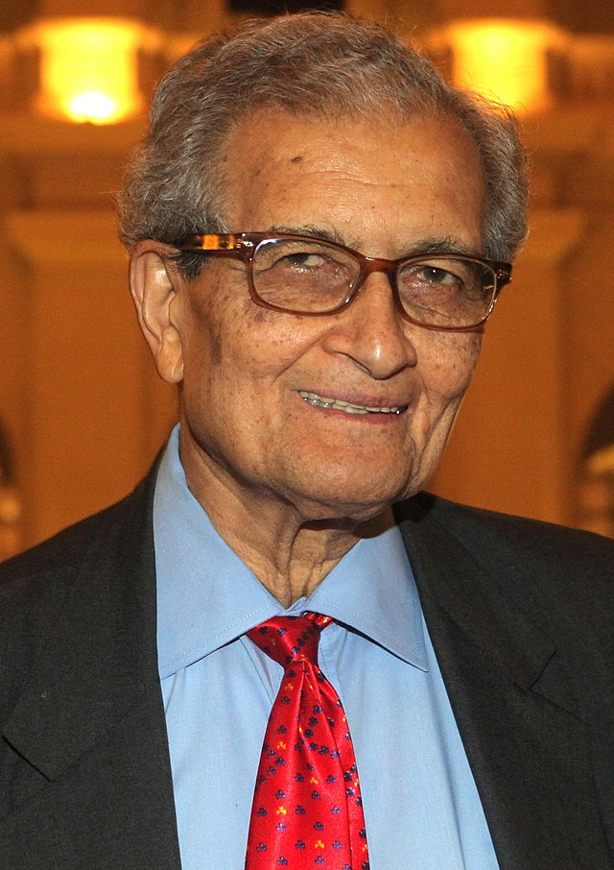
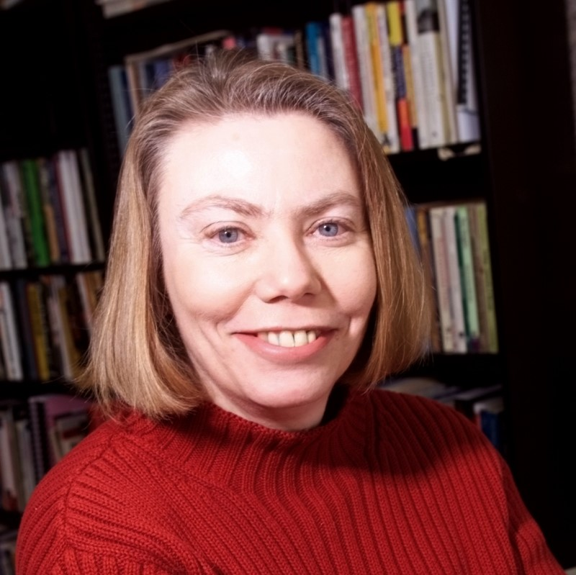
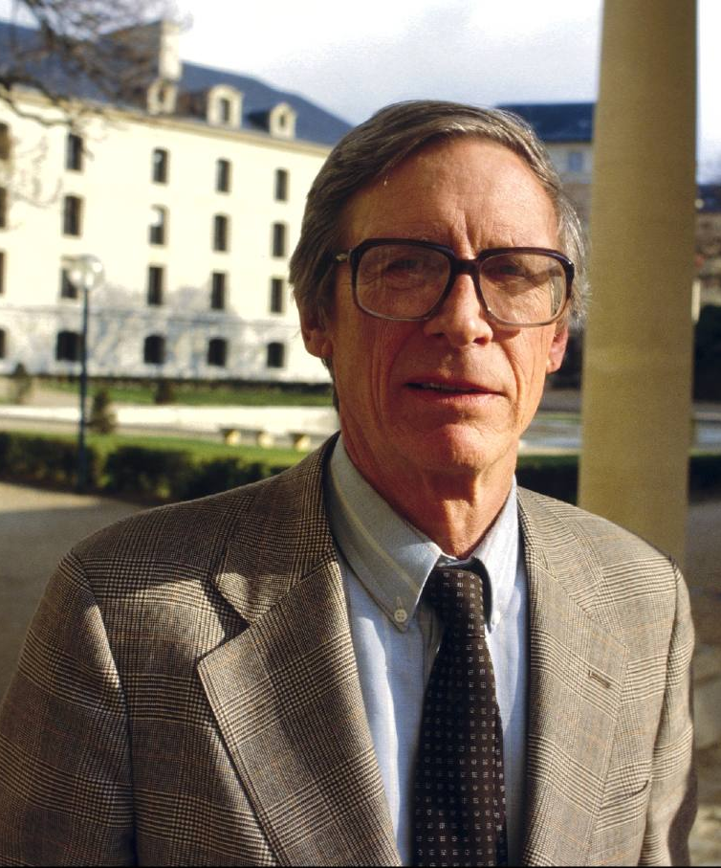
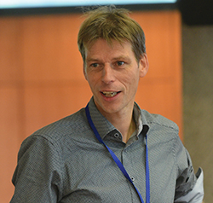
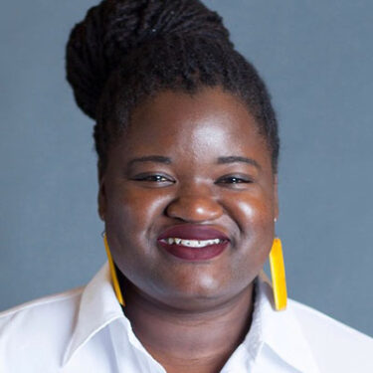
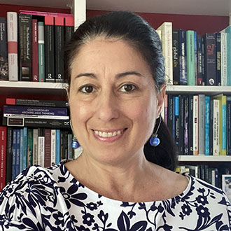
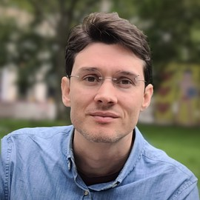

Slide 20
Our justice principle when we don’t talk about equity.
Philosophies of justice
Government agencies do not act without implicitly acting on a philosophy of justice.
When equity is not defined, our other priorities reveal our view of justice.
Utilitarianism: picking the alternative that maximizes total user benefits system wide, regardless of distributions.

Slide 21
The other extreme: Equality, or ‘vertical equity’
Philosophies of justice
Ensuring everyone has the same level of access, or freedom of movement.
Rarely an adopted policy goal: network effects make perfect equality impossible.
Not even desirable?

Slide 22
Gap minimization or egalitarianism
Philosophies of justice
Inequality is inevitable, but we should seek to minimize it such that:
The resulting inequalities are part of whichever plan or scenario does the most to help those with the least.

Slide 23
Sufficientarianism
Philosophies of justice
Define a level of access or mobility that each person needs to live a reasonably good life.
Ensure your plan meets that standard for all residents.
Any inequities beyond that are fine!

Slide 24
Suppose we run with one of these standards, how do we measure? State of the art:
Measuring Access

Slide 25
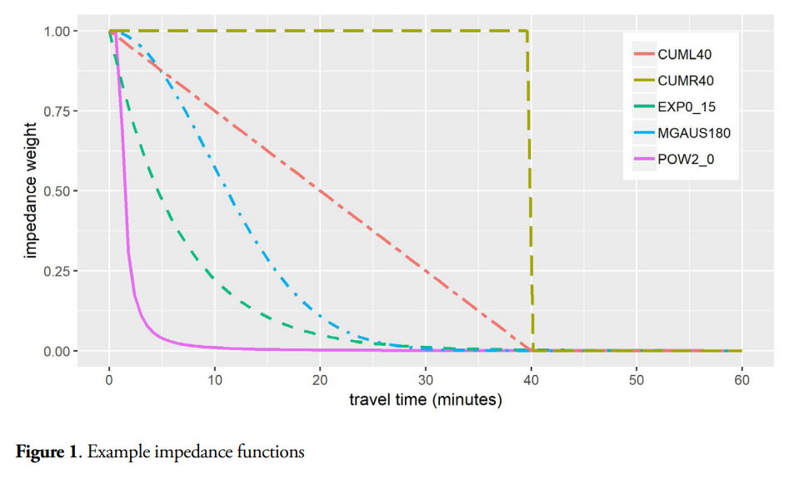
Growth in access measurement
State of the art
Weighting the value of destinations using gravity functions (Santana Palacios and El-Geneidy, 2022);
Accounting for variation in access by time of day (Farber and Fu, 2017);
Weighting destinations to account for competition from other origins (Soukhov, Páez, et al., 2023);
Creating composite indices composed of access scores to different kinds of destinations (Klumpenhouwer and Huang, 2021);
Incorporating monetary costs through a generalized cost index (El-Geneidy et al., 2016);
Incorporating observed travel times rather than scheduled time (Wessel, Allen and Farber, 2017).

Slide 26
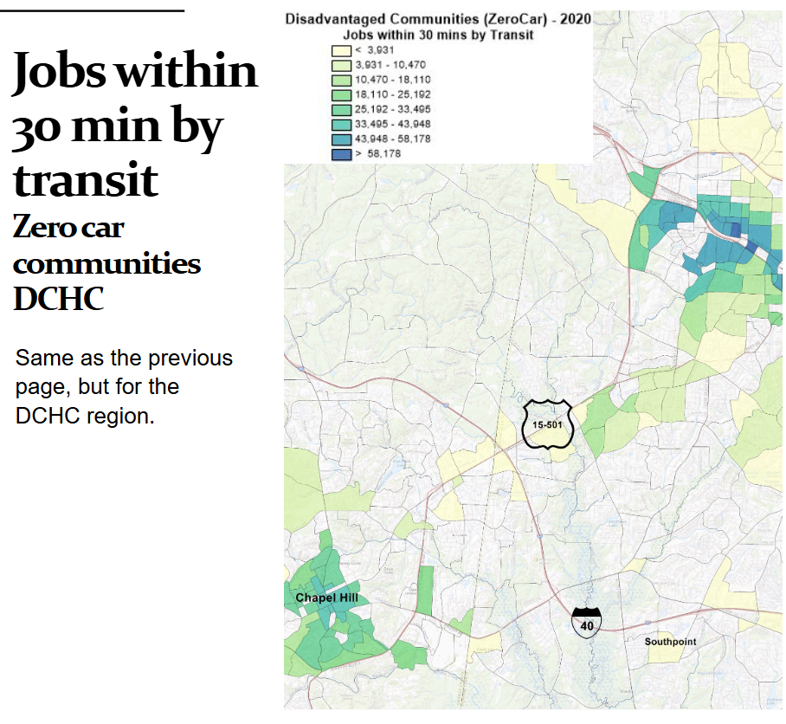
Lets say we’re using “number of jobs reachable in 45 minutes by transit.” How do we assess it relative to those philosophies of justice?

Slide 27
Foster-Greer-Thorbecke (FGT) poverty measures (1)
Measuring Access state of the art
When 𝛼 = 0, FGT0 measures the extent of poverty as a simple headcount—the proportion of people below the poverty line.
For 𝛼 = 1, FGT1 measures the severity of poverty as the average percent distance between the poverty line and the accessibility of individuals below the poverty line (a.k.a. the “poverty gap index”)
When 𝛼 = 2, it simultaneously measures the extent and severity of poverty by calculating the number of people below the poverty line weighted by the size of the accessibility shortfall relative to the poverty line.
where N is the size of the total population, z is a poverty line previously defined, H is the number of individuals below the poverty line z, 𝑦𝑖 is the “income” or accessibility level of each individual i, and 𝛼 is a parameter that determines how sensitive the index is to changes in the poverty gap.

Slide 28
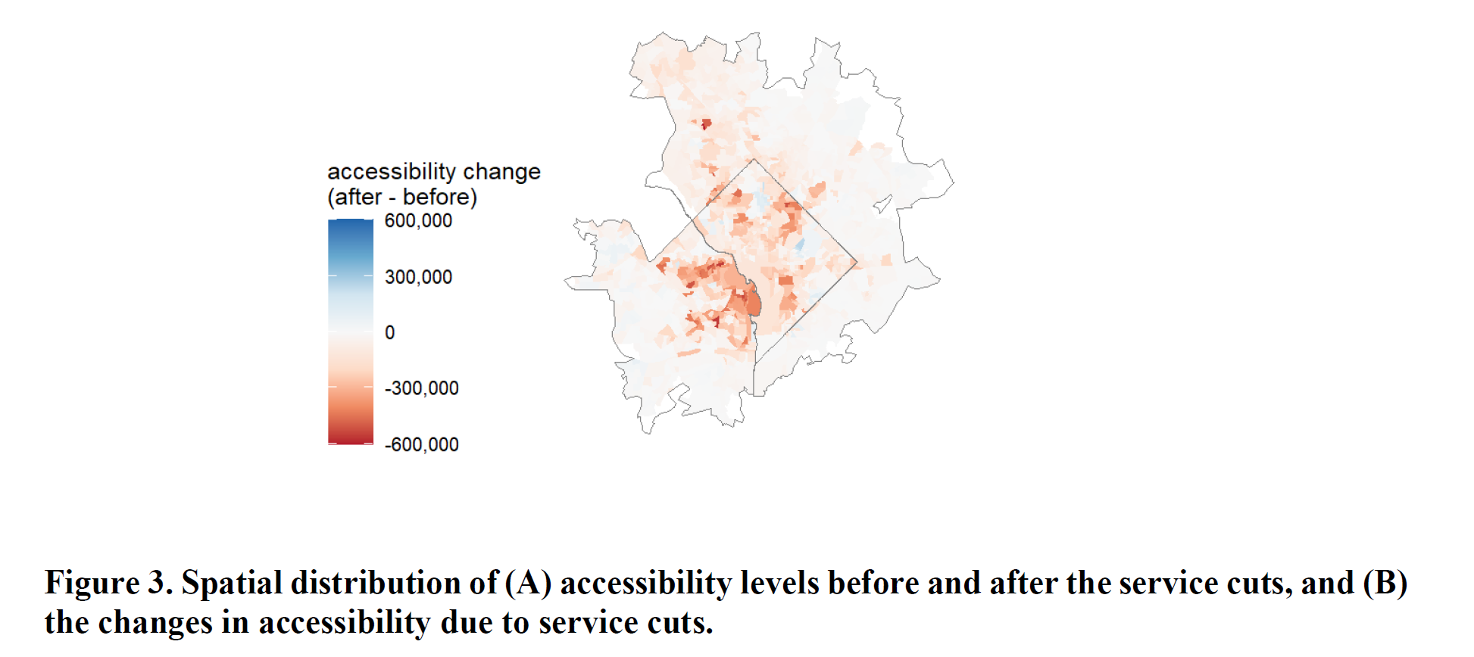
FGT case: WMATA cuts after COVID-19
Measuring Access state of the art

Slide 29
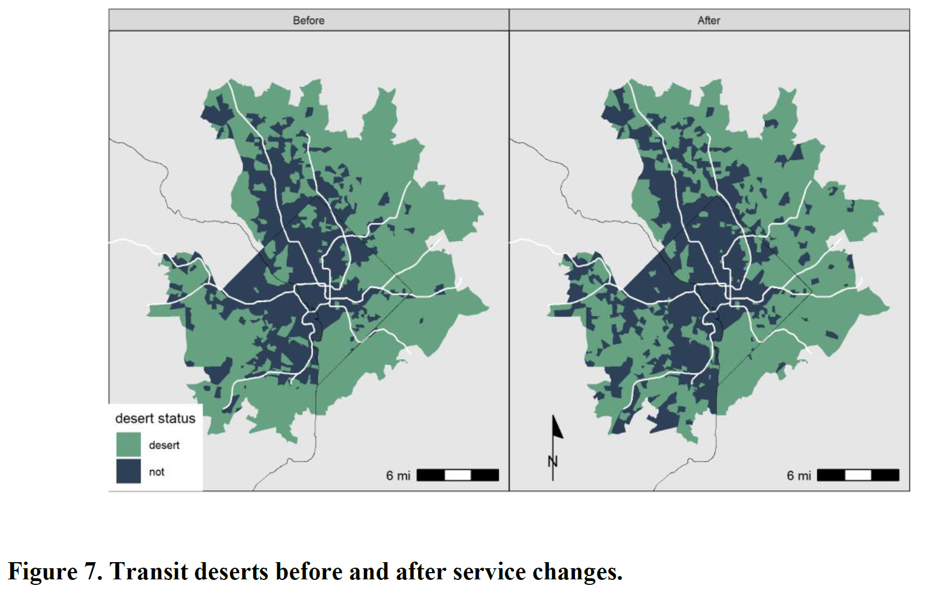
What ‘transit desert’ approach said about the cuts
Measuring Access state of the art
Spatial extent of transit deserts shrunk during COVID-19 period!
The number of people living in a transit desert shrunk by 60,000.

Slide 30
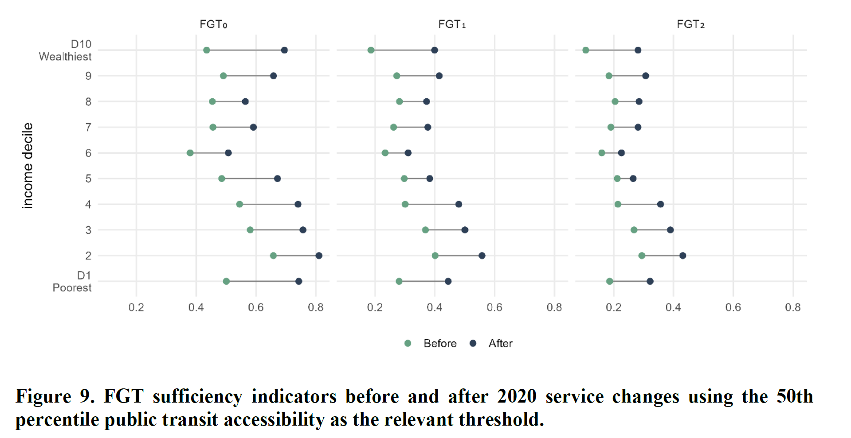
Measuring Access state of the art

Slide 31
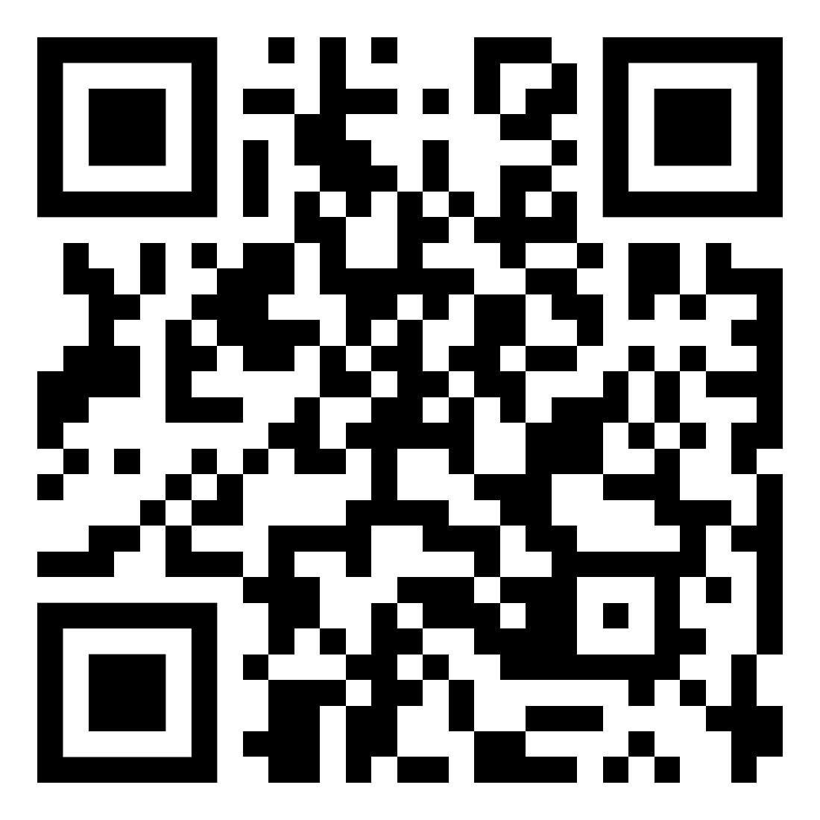
Takeways:
STATE OF ART
Share in access poverty, and the severity of that poverty, grew for lowest income households.
Measuring average differences or average changes would have masked these findings.
More simplistic ‘transit desert’ approach also masked these impacts.

Slide 32
A travel model-based alternative: the LogSum
STATE OF THE ART

Slide 33
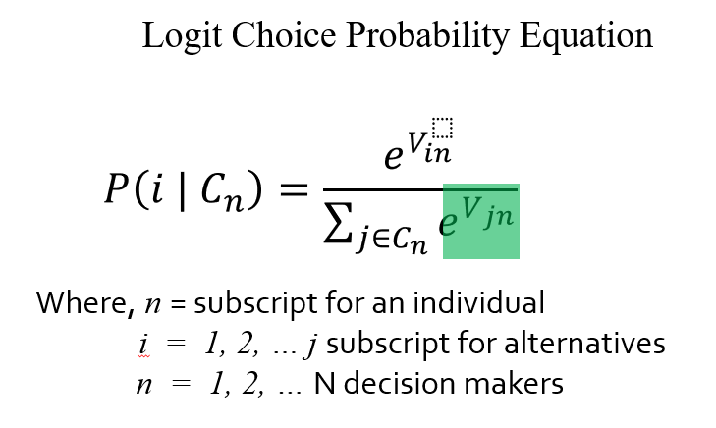
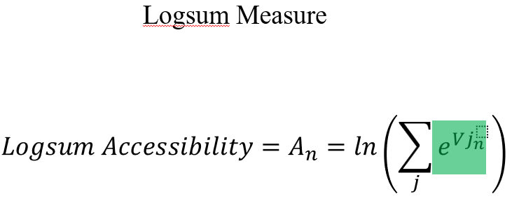
The LogSum
STATE OF THE ART
Summing up the exponential utilities of all alternatives in a choice set.
The total “attractiveness” of the traveler’s options.
An all-encompassing measure of ‘benefit’
Figures from Bills, 2019.

Slide 34
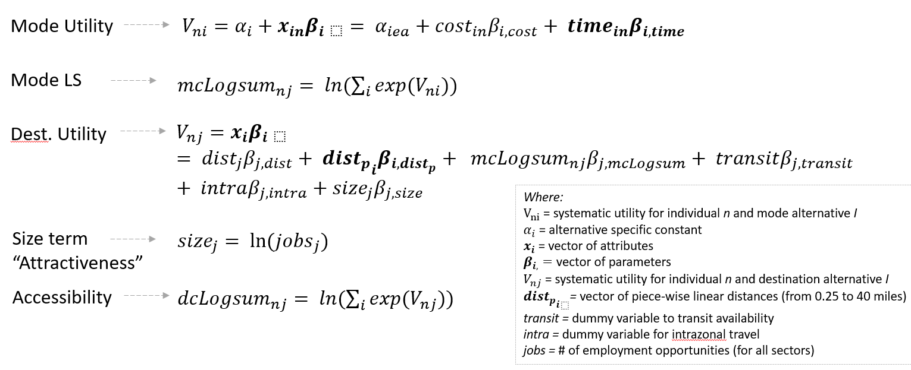
State of the art
Figures from Bills, 2019.

Slide 35
LogSum applied to Two MTP scenario (Bills 2024)
MTC (San Francisco Area) 2013 RTP.

Slide 36
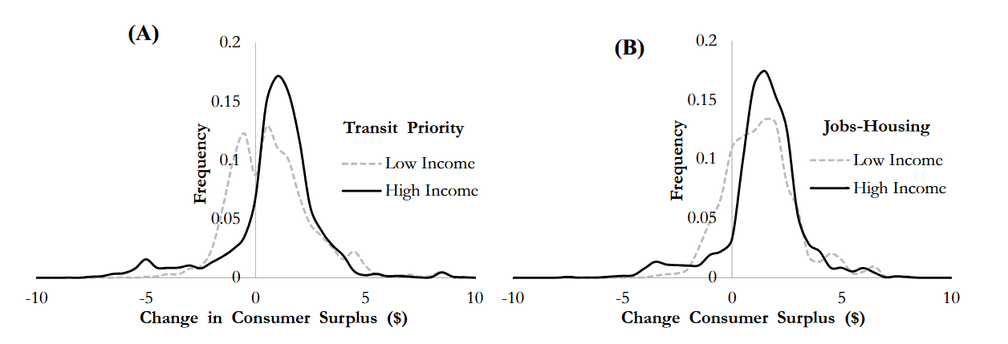
Applying LogSum to compare two MTP scenarios (Bills, 2024)
STATE OF the ART

Slide 37
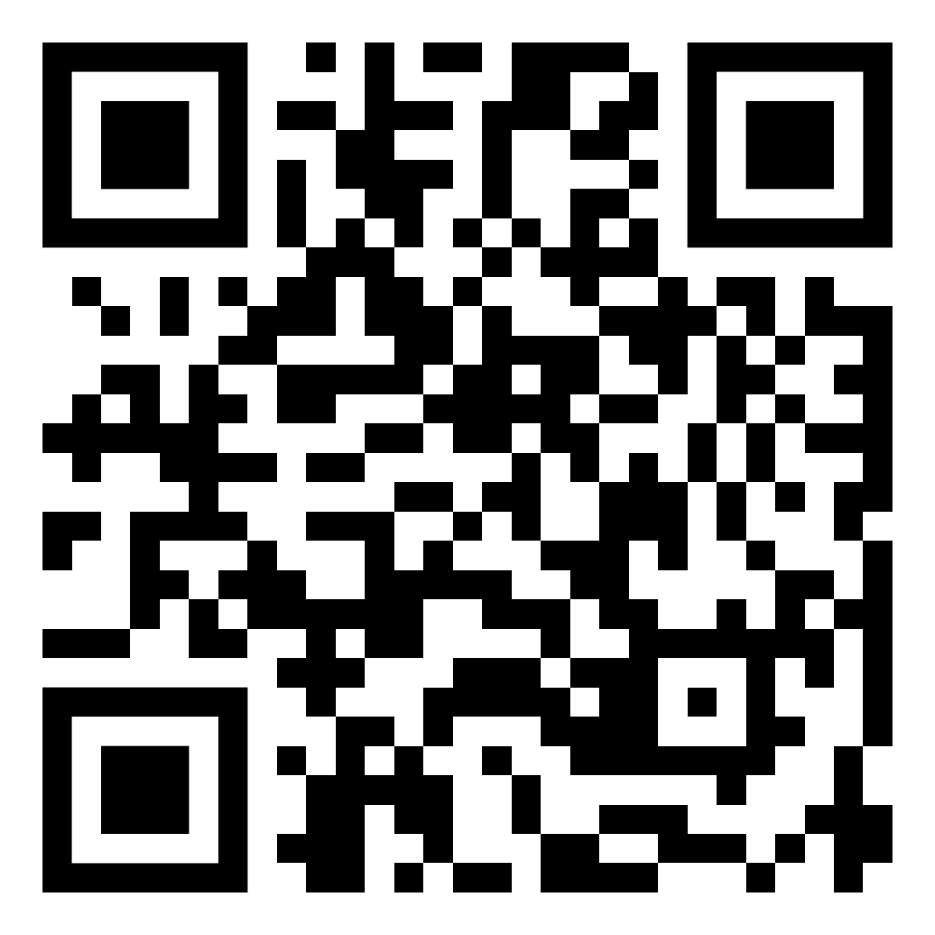
Lessons (Bills, 2024)
STATE OF the ART
Applying egalitarian principle that the best plan is the one that is best for those with the least…
Jobs-Housing balance scenario
Why?
Even though inequity is minimized under ‘transit priority,’ low income travelers were still worse off.
Under egalitarianism, inequality is ok when the worst off are better off for it.

Slide 38
Conclusions

Slide 39
Travel demand modeling can help advance fairness
Conclusions
Justice includes distributional equity or fairness
Unfair distribution of benefits risks reducing participation in society and the economy.
Access is the broadest and most comprehensive measure of benefits.
New ways of measuring access and the fairness of distributions are available:
FGT poverty measure (requires defining an ‘access poverty’ level).
LogSum to incorporate changes in utility.
Travel demand model outputs can provide the data needed to conduct these analyses.

Slide 40
Questions? palmmatt@unc.edu
Planning.unc.edu
(reference list to be shared out)

Slide 41
Carolina Blue Slide with White UNC Logo

